Slide 1
Slides for defense

Slide 2
sleeping
Aspalin/ABA
Coffee/GA
Bed coat: Coat of seed, structure of spike
Cold,hot, fire, water, light

Slide 3
Future research plan
Make good use of exist genotyped populations:
US GWAS POP
Global collection of stripe rust GWAS
5 DH population for consences map, genotyped by 90k snp
BT-Schomburgk x AUS33384 Young x AUS33414 Chara x Glenlea W7984 × Opata M85 Sundor x AUS30604 Westonia x Kauz

Slide 4
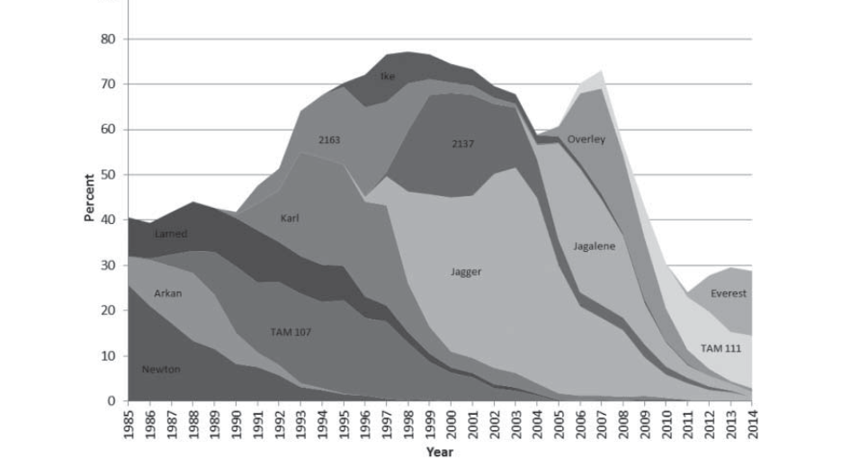

Slide 5
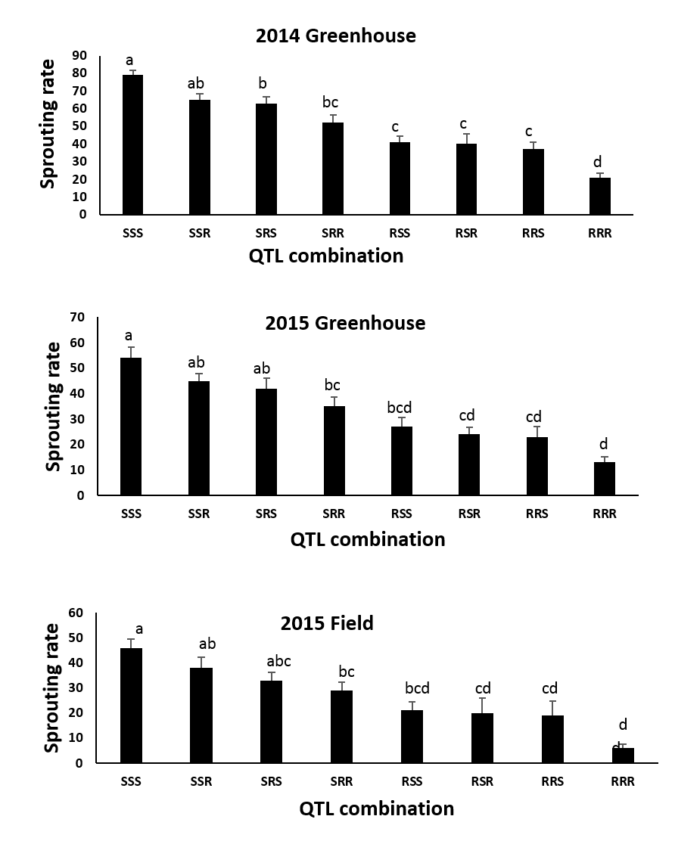

Slide 6
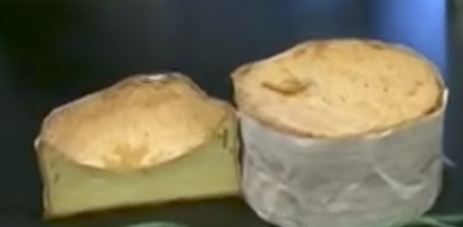

Slide 7
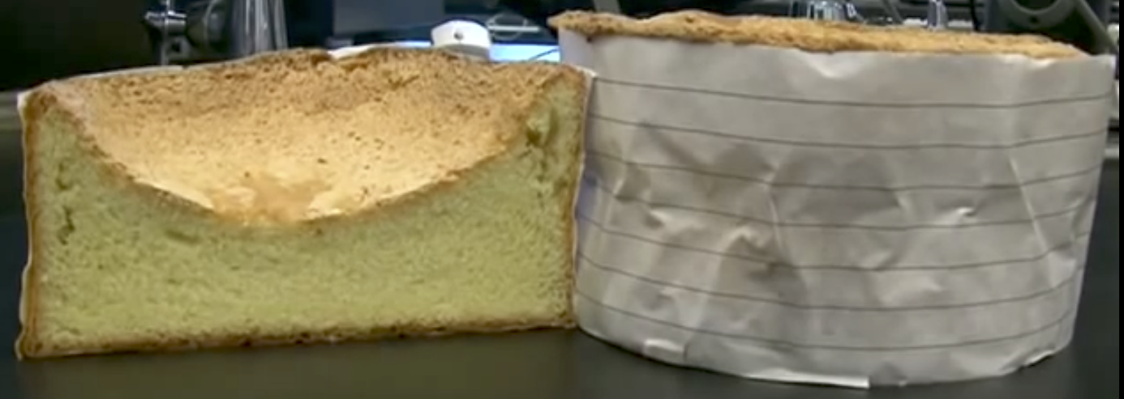
https://www.youtube.com/watch?v=YMjhdSskXP0

Slide 9
LMA
To induce LMA in the greenhouse, plants are grown (80o F day/65o F night), and then tagged when pollen is shed. After 25 days, these plants are placed in a cold chamber with a 64o F day and 45o F night for 8 days to induce a cold shock. Once treated plants reach maturity, alpha-amylase levels are mea- sured using the Phadebas® assay.

Slide 10
By breeding wheat with a reduced risk of low FN without compro- mising emergence, we can avoid falling cakes, mushy noodles and farmers’ falling number blues.

Slide 11
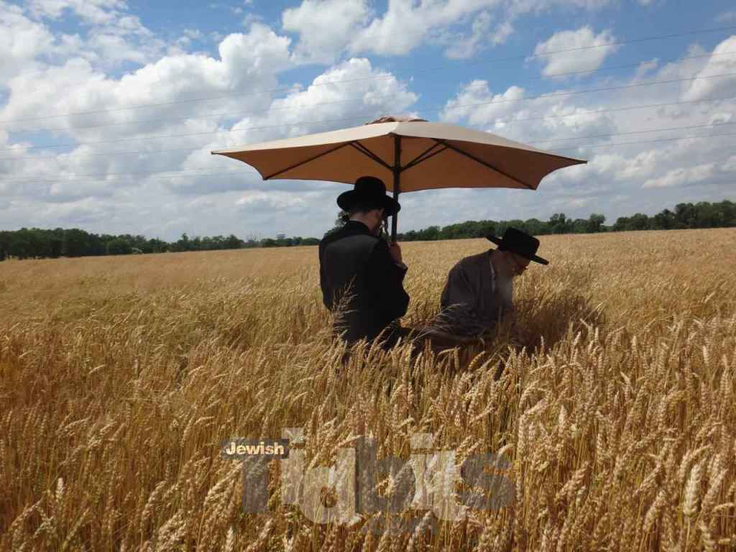
http://jewishtidbits.com/serdaheli-rav-cutting-wheat-matzos/#jp-carousel-48921

